Slide 1
Power Amplifiers
Instructor: Engr. Hira Akash

Slide 2
Power Amplifiers
Introduction
Power relation in class-A amplifiers
Class-B amplifier
Efficiency of class-A and class-B amplifiers.

Slide 3
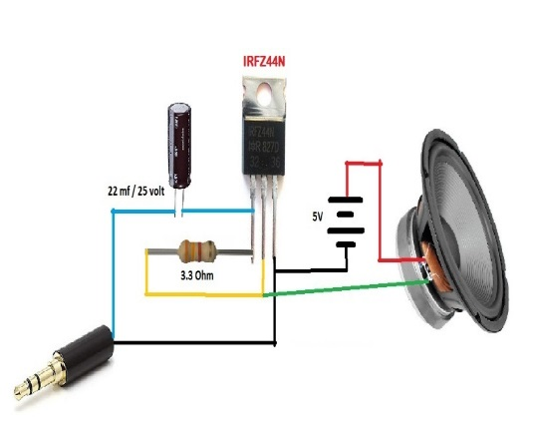
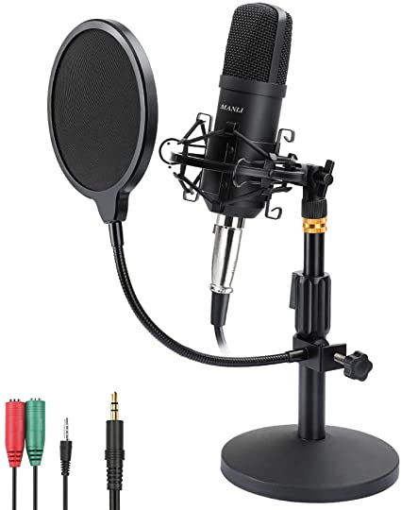
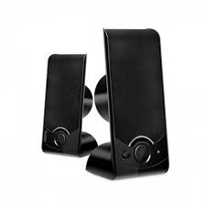
Power amplifier
An amplifier, electronic amplifier or (informally) amp is an electronic device that can increase the power of a signal.
It is a two port electronic circuit that uses electric power from a power supply to increase the amplitude of a signal applied to its input terminals, producing a proportionally greater amplitude signal at its output.

Slide 4
Amplifier classes
Power amplifier circuits (output stages) are classified as A, B, AB and C for analog designs—and class D and E for switching designs.
The classes are based on the proportion of each input cycle (conduction angle) during which an amplifying device passes current.
The image of the conduction angle derives from amplifying a sinusoidal signal.
If the device is always on, the conducting angle is 360°.
If it is on for only half of each cycle, the angle is 180°. The angle of flow is closely related to the amplifier power efficiency.

Slide 5
Class A amplifier
In a Class A amplifier, 100% of the input signal is used (conduction angle Θ = 360°). The active element remains conducting all of the time.
Amplifying devices operating in class A conduct over the entire range of the input cycle.

Slide 6
Class B amplifier
In a class-B amplifier, the active device conducts for 180 degrees of the cycle. This would cause intolerable distortion if there were only one device, so two devices are usually used, especially at audio frequencies. Each conducts for one half (180°) of the signal cycle, and the device currents are combined so that the load current is continuous

Slide 7
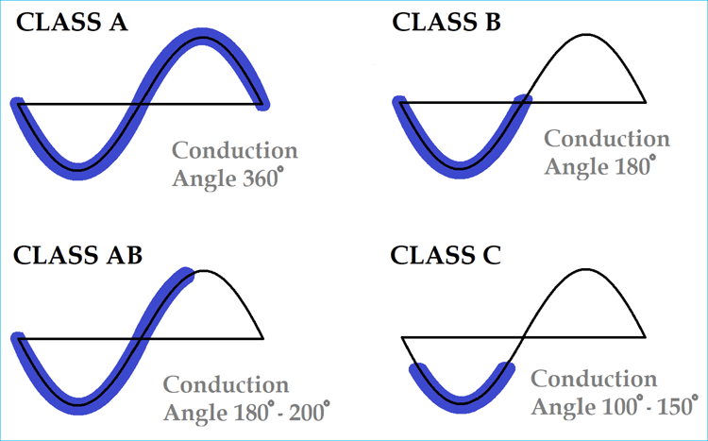

Slide 8
Which class amplifier is best?
Class A Amplifier
Class “A” amplifiers are considered the best class of amplifier design due mainly to their excellent linearity, high gain and low signal distortion levels when designed correctly.

Slide 9
Application of amplifier
An Amplifier or an operational amplifier (op-amp) circuit is commonly used in the automation, control and other electronic circuits for marine applications.
The applied input signal is usually a voltage or a current signal.
The purpose of an amplifier is to produce an output signal larger than that of the input signal

